Slide 1

Code 102: Intro to Software Development
Class 03

Slide 2
Agenda
Review of previous class
Share your learning
Sharing Code
Understanding git
GitHub
git-flow
Deployment
GitHub Pages
Demo
Assignments
Reading & Lab
Notes:
Here’s our plan for class today

Slide 3
Agenda
Review of previous class
Share your learning
Sharing Code
Understanding git
GitHub
git-flow
Deployment
GitHub Pages
Demo
Assignments
Reading & Lab
Notes:
Here’s our plan for class today

Slide 4
<review>
What did you learn?
Notes:
There are 4 skills in language learning: Hearing, speaking, reading, writing (and we generally develop them in that order).
These review sessions are your chance to SPEAK with this new language. Practice using the right words. Let these foreign sounds emanate from YOUR mouth. The names of these esoteric characters matter, and using the wrong one will make a difference to the computer.
Go around the room. Each student can share a thing learned, or a sentence from their Learning Journal. Help them use the right words. Document the vocab as necessary on the whiteboard.
Ask specifically for what was learned by reading about other student’s learning.

Slide 5
Agenda
Review of previous class
Share your learning
Sharing Code
Understanding git
GitHub
git-flow
Deployment
GitHub Pages
Demo
Assignments
Reading & Lab
Notes:
Here’s our plan for class today

Slide 6
<git>
Sharing code and collaboration: dvcs for the masses
Notes:
TELL: Collaboration is what makes large coding projects possible! Let’s take a look at how web software developers share code.

Slide 7
What is git?
It’s a version control system.
It lets multiple developers work on the same code
A history of changes to your files
The ability to view, apply, and remove those changes
Keep all of your project files in one repository
It makes collaboration possible!
Notes:
TELL:
A "version control system."
A history of everything you do to your files.
A record of "states" in which your files has existed.
A way to organize project files using repositories (a repository is simply a collection of things you care about).
All of the above means that Git is highly effective at maintaining the cohesiveness of group collaboration.
Git is used to save and backup work, share your code and collaborate on projects.

Slide 8
Without version control
Look familiar?
term_paper.docx
term_paper2.docx
term_paper2_with_footnotes.docx
final_term_paper.docx
term_paper_for_submission.docx
term_paper_for_submission_for_real.docx
Notes:
TELL: I’m sure some of you are guilty of this!

Slide 9
Snapshots in time
Commits represent each successive version of a file or files.
Commits are the Git equivalent of “Save As…”
A
Notes:
TELL:
Git uses “commits” to represent each successive version of a file or files.
Commits are similar to “Save As…”, but better.

Slide 10
Snapshots in time
Each successive version creates a new snapshot on the timeline of the project.
A
B
Notes:
TELL: Each successive version creates a new snapshot on the timeline of the project.

Slide 11
Snapshots in time
Git keeps track of what the file looked like at different points in time.
A
B
C
term_paper.docx
term_paper2.docx
term_paper_with_footnotes.docx
Notes:
TELL: When you do a Save without version control, you only ever have the most recent version of the file. You can’t go back to an old version, unless you saved that as a different file.
TELL: Version control lets you have one file - but it remembers what changes were made. We continue to update and revise the files in our project Git helps us keep track of where we are and where we’ve been. Think of each snapshot, or “commit” as each new version of the paper you were saving. However, instead of making a full copy of every file, it only keeps track of the actual differences between each version, making it very efficient and fast.

Slide 12
Keeping track
Each commit (snapshot) has a label that points to it
HEAD = The label meaning “You Are Here”
You can also assign messages to commits
Messages are like writing a caption for your snapshot
HEAD
A
B
C
Notes:
TELL: Each snapshot, or “commit,” can also have a label that points to it. One of these is HEAD, which always points to the place in the timeline that you are currently looking at. You can think of HEAD as being “You Are Here.”

Slide 13
A summary of git
You use Git to take snapshots of your code at points in time
Git keeps a history of what those snapshots look like
Git has a special label, called HEAD, that means “You Are Here”
Usually you give a snapshot a label called a message
A
B
C
Notes:
TELL: A git repository is a set of points in time, with history showing where you've been.
Each point has a name (here A, B, C) that uniquely identifies it, called a hash.
Each commit also has a user-generated message which describes its purpose.
The path from one point to the previous is represented by the difference between the two points.

Slide 14
<GitHub>
Your code, in the cloud.
Notes:
TELL: GITHUB is awesome! Let’s explore the one of the technologies that enables people from all over the world to work on open source software development projects!

Slide 15
What is GitHub?
A way to share code with others!
An online place to store your code. (Backup is good!)
It uses Git to help you manage your team’s work:
Version tracking
Reviewing changes
Keep changes separate until you want to add them in
Notes:
TELL: Remotes serve as a way of sharing work with other developers. GitHub has emerged as a premier location for such sharing. It provides you with a common location that anyone can access. In addition, it provides a number of useful tools for managing work that is being shared among a dispersed group of people.
Git is designed to be a ‘distributed’ system, where you can share code between any connected computers.
GitHub gives you a centralized ‘canonical’ repo that a team can access for the latest contributions from across the team.

Slide 16
git + GitHub = awesome
With Git (version control) and GitHub (online code storage), you can:
Have lots of team members work together on the same files, without messing each other up
Keep a history of each file over time
Work on code on your own computer, and sync it with what’s online
Notes:
TELL: Git and GitHub let you manage work for teams...or just yourself.
You can keep a detailed history of what your code looked like, at different points in time
Keep changes separate, until you want to add them in
Lets you keep the code you have on your own computer in sync with what’s in your online storage

Slide 17
<repositories>
AKA: repos.
Notes:
NOTE: You can go step-by-step and opt to have students follow along during this section, and then take out the following “deployment” work time. With larger groups it is better to demo it, and then have them work from the slides and github guide as you and the TAs come around to help.

Slide 18
What is a repository?
A repository is a collection of files that you’ve told Git to pay attention to
Usually, one project = one repository
Really large projects might have multiple repositories for different parts of their system (ie: front end vs back end)
Repositories can live on GitHub and/or your computer
Let’s make one now!
Notes:
DO: After reviewing this slide, it’s time to break away from the slide deck for a bit. Open up your web browser and pull up your github.com account. Walk students through the process of creating a repository, cloning that repository on to their local machines, adding an index.html and style.css file and links for any additional pages. Then it’s time to “add”, “commit”, and “push” up their code. NOTE: They’ll be using github.io for deployment. Review the following to ensure a proper workflow: https://pages.github.com/ To recap the steps needed for deploying:
create a repository in github clone the repository onto your local machine create/add files and related code
run git add <filenames> to stage the file(s) for commit run git commit -m “initial upload” to commit your changes run git push origin master to upload the files/changes to github
DO: Make a repo on GitHub
Create a new repo. MAKE SURE STUDENTS GIVE IT THIS NAME: theirusername.github.io
Check the “Initialize this repository with a README” option and click Create repository.
Common problems: repo name doesn’t match their username; not checking the README box.
Explain that different repos can be linked to each other. That means they can get and give code to/from each other.
Show them how to copy the clone url
DO: Clone it locally:
Have them navigate to their projects folder (they should have made this earlier, when you saved the html file the first time)
Show them how to execute the clone command in their terminals
Using the finder, move all files needed for the project into their newly created local repo folder.
cd into the local repo folder and ls to check that all the files are there.
Common problems:
files not in the projects folder;
forgetting to cd into local repo folder;
one file not named index.html.
DO - GIT/GITHUB Walkthrough:
Git status
Git add
Git commit
Git push
Verifying that their code is on GitHub
Common problems:
forgetting to put -m on git commit -m and ending up in Vim;
wrong repo name;
no file named index.html
DO: Deployment Walkthrough
Explain that one of the things GitHub comes with is GitHub Pages - turning your code into a site the world can see. If your repo is named “somenamehere.github.io”, then it will look for the index.html file and deploy it! (Explain what “deploying” is.)
(Editor’s note: yes, you can also do github pages if you don’t have a repo named “somename.github.io”, but then your files need to be on the gh-pages branch. We’re leaving the concept of branching to 201.)

Slide 19
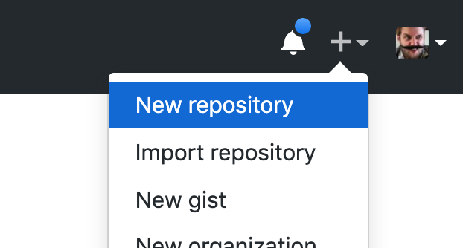
Creating a repo on GitHub
Log in to GitHub.
At the top right side of the window, look for your name and avatar.
Next to it you'll find a small + sign. Click that.
From the menu that opens, select New repository.

Slide 20
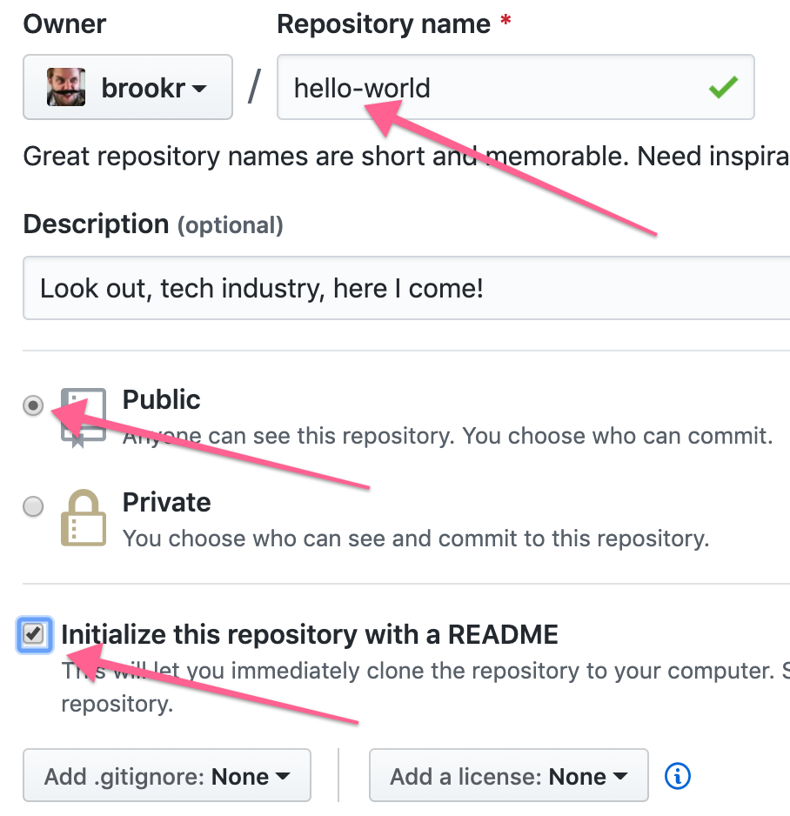
Creating a repo on GitHub
Repos can be named anything…
But pick something meaningful
Add a description
Check Initialize this repository with a README.
Click Create repository.

Slide 21
Linking repos
Congrats! You just made a new repo.
Now we need to copy this repo onto our computers, and connect the two repos to each other.
If they’re connected, they can give and receive code from the other repo.
We’ll do this by cloning: from the cloud, to our local machine

Slide 22
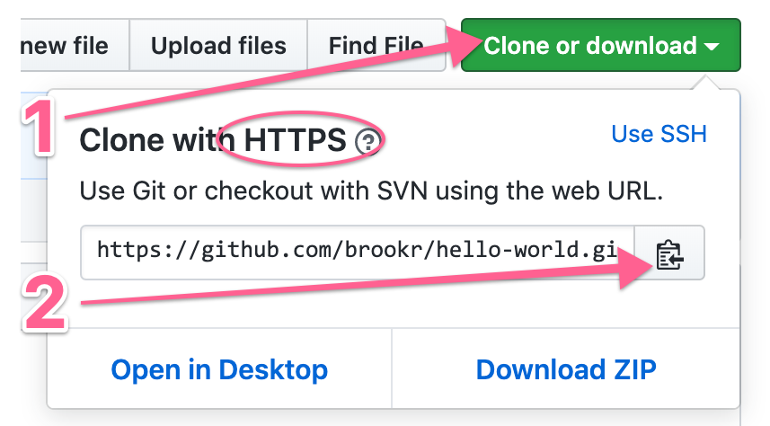
Clone that repo
1: Click the big green button that says Clone or download. Ensure it says “HTTPS”.
2: Then, copy the URL using the Copy to clipboard button shortcut.

Slide 23
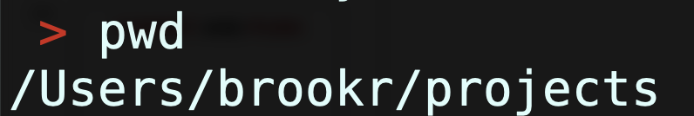
Start in your projects folder
Open up your terminal
Use your cd and ls commands to navigate into your projects directory
If it doesn’t exist, go to your home directory: cd ~
And make a folder to hold all your repos: mkdir projects
Then change into it: cd projects
Check where you are with pwd (“print working directory”)

Slide 24
Using git clone
In the projects directory:
Type: git clone
Follow that with a <space>
Paste in the link you just copied
It should look something like:
Ready? Hit Enter.

Slide 25
Using git clone
What just happened?
You made a new folder, hello-world (see it with ls)
The new folder is a local repo in sync with the one on GitHub
Change into that directory
See the URL of the GitHub repo by typing git remote -v
It made a directory that has all the files in it you had online
> cd hello-world
> git remote -v

Slide 26
<gitflow:acp>
Add, commit, push
Notes:
Add, commit, and push

Slide 27
Using git status
Now that your files are in your repo, we need to make a commit (take a snapshot of them).
Review the current status of your files by typing git status
It will tell you what files have changed since your last commit.
Right now, git is paying attention to 1 file (README.md)
> git status

Slide 28
Using git status
Edit that file with VS Code
Open the current folder in the editor
Make changes
Save your changes
...and see how git status reports the change
> code .

Slide 29
Using git add
Next: we need to tell git what changes to commit.
This is done by typing git add and then a filename.
This tells git to include these changes in the next snapshot.
Think of it as placing items into a scene to photograph
Type git status again to see the difference!
> git add README.md

Slide 30
Using git commit
Finally, take that snapshot!
Type git commit -m “your message goes here”
git commit is the shutter-button to take the snapshot
-m specifies the message included with the commit
Think of the message as being like a photo caption:
Why is this moment significant?
> git commit -m “Adds initial greeting to the world”

Slide 31
Using git push
Great! Now it’s time to sync this code to your repo on GitHub.
Type: git push origin master
git commit is what takes the snapshot
This sends any new commits (the snapshots of your code) to GitHub.
Go to your repo on GitHub, and look for your files!
> git push origin master
Counting objects: 6, done.
…
To git@github.com:brookr/hello-world.git
* [new branch] master -> master

Slide 32
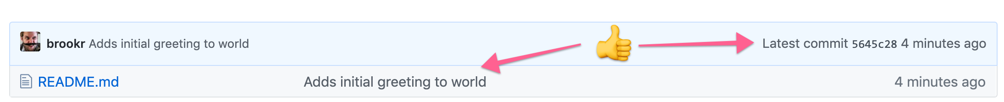
Verify on GitHub
In your browser on GitHub you will see the changes that you pushed, as well as the commit message, and the commit id.

Slide 33
Agenda
Review of previous class
Share your learning
Sharing Code
Understanding git
GitHub
git-flow
Deployment
GitHub Pages
Demo
Assignments
Reading & Lab
Notes:
Here’s our plan for class today

Slide 34
<deployment>
Look at you, publishing your code for the world to enjoy!
Notes:
Make it live, on the internet!

Slide 35
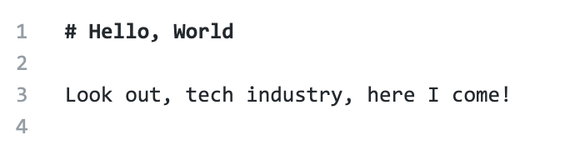
GitHub Pages
Any repo can be published with GitHub Pages
Each repo can be styles with a theme
Whenever you push changes, the published site will update
That’s called “deployment.” It turns this markdown...

Slide 36
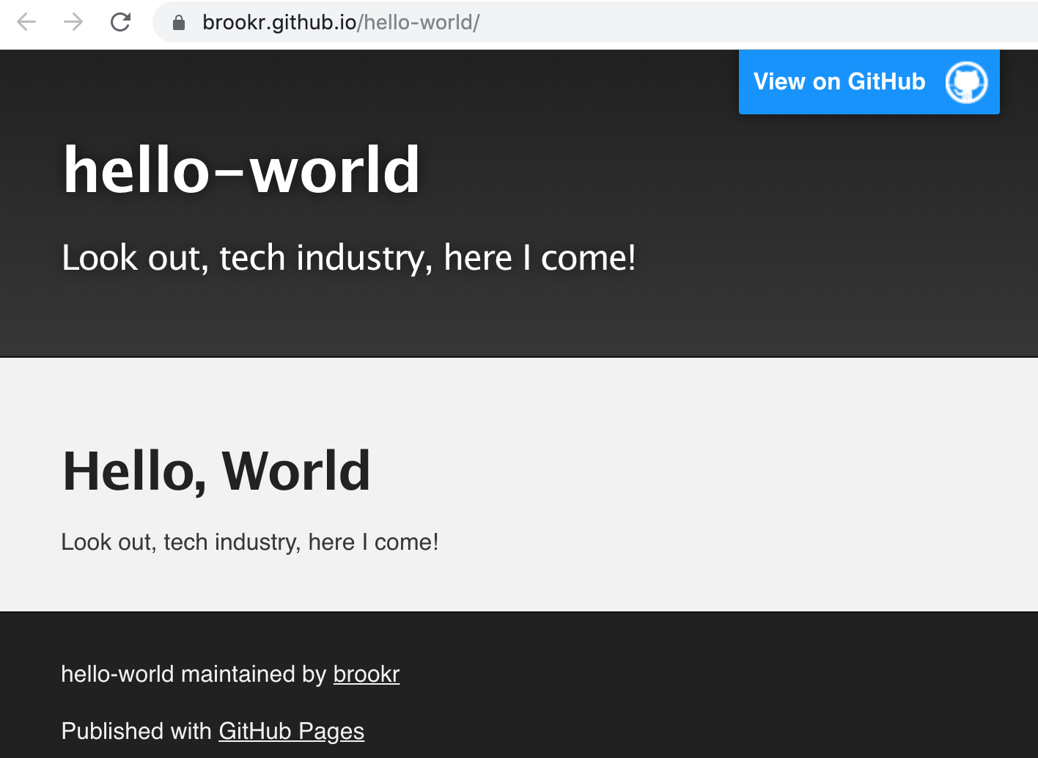
GitHub Pages
...into this web page
Your web page URL is: USERNAME.github.io/REPO-NAME/

Slide 37
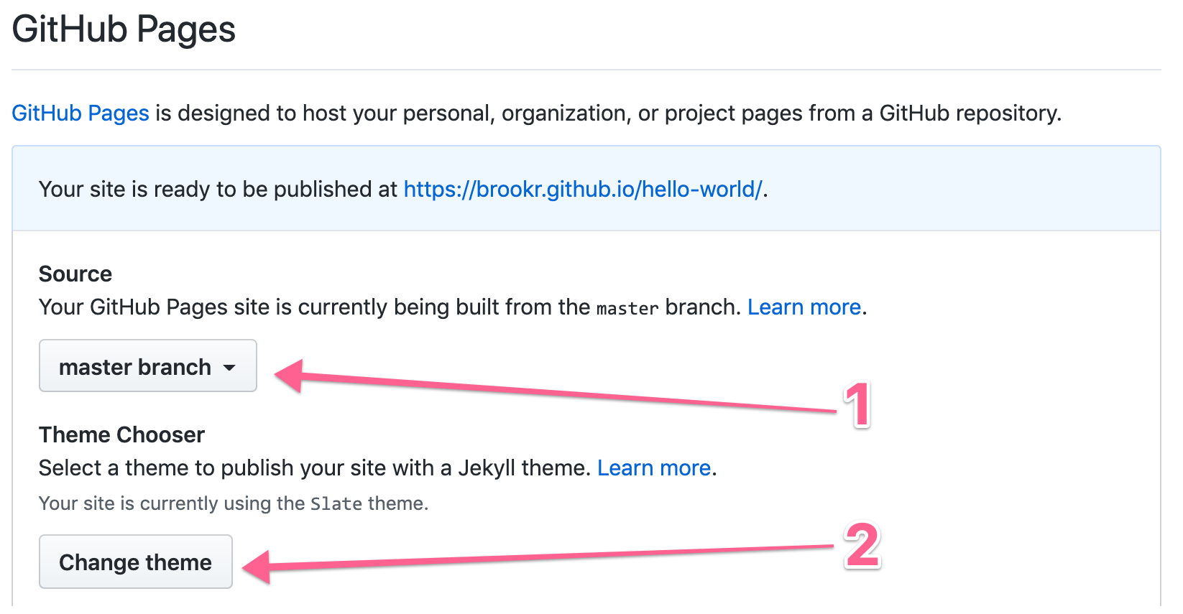
GitHub Pages
Go to your GitHub repo settings, scroll down towards the bottom
Activate publication by selecting a source

Slide 38
Show off!
Congratulations! You have successfully deployed your awesome work on the world-wide web.
Now you can share that link with friends and family, and they can see what you did.
Tweet it! Ig it! Fb it! Let the tech world know you are here!

Slide 39
Agenda
Review of previous class
Share your learning
Sharing Code
Understanding git
GitHub
git-flow
Deployment
GitHub Pages
Demo
Assignments
Reading & Lab
Notes:
Here’s our plan for class today

Slide 40
<assignments>
Lab: Clone & edit your LJ Site
Read: Make a page about git
Notes:
Go go go!

